Slide 1

PHYS 101: GENERAL PHYSICS I
Instructor: Dr. Raymond Edziah
E-mail: redziah@ucc.edu.gh
Office: Located in Dept. of Physics, between Labs II & III
Office Hours: By Appointment & walk-ins before 4:30 PM

Slide 2
COURSE DETAILS
Credit: 2 (2 hrs of lecture and 1 hr of recitation (to be arranged)
Course Textbook: Physics for Scientists and Engineers, by Raymond A. Serway and John W. Jewett
Reference Books:
Physics for Scientists and Engineers (3rd Edition), by Randall D. Knight,
Any other relevant undergraduate physics textbook

Slide 3
COURSE OUTLINE
Methods of Evaluation
Homework Policy
Exams
Tests (HW, tests, attendance, class
participation, random quizzes): 40 %
Multiple-Choice Final Exam: 60 %.

Slide 4
CLASS POLICIES
No food or drink is allowed in the class.
Cell phones must be turned off/silenced
Start of class/lateness
Absence from class
The Handicapped
Lateness policy
Homework policy

Slide 5
ELECTION OF COURSE REPS
Class Reps
National Service Person (to be introduced)

Slide 6
LECTURE 1: INTRODUCTION – PHYSICS AND MEASUREMENTS
What is Physics?
Exact (Fundamental) Science
  Concerned with the fundamental principles of the universe
  Foundation of other physical sciences
  Has simplicity of fundamental concepts

Slide 7
PHYSICS, CONT.
Other exact sciences are chemistry, biology and engineering
In exact sciences, the definition of any quantity must provide a set of rules for calculating it in terms of other quantities that can be measured
Contrary, in soft sciences (psychology, political science, etc) quantities are not always defined in terms of variables

Slide 8
PHYSICS, CONT.
Physics can be defined as the study of the natural world, i.e. the study of matter and energy
Physics is sometimes referred to as natural philosophy

Slide 9

HOW DOES PHYSICS DIFFER FROM OTHER EXACT SCIENCES?
Chemistry: The study of
interaction of elements &
compounds
Biology: The study of living organisms
Engineering: The science by which properties of matter & energy are made useful to mankind

Slide 10
PHYSICS, CONT.
Physics differs from chemistry, biology, engineering,…not so much in method but principally in emphasis
Physics is sometimes considered as the most fundamental science because it is the basis of all the other fields of science
“Physics is what physicists do”, in research labs & universities worldwide

Slide 11
OBJECTIVES OF PHYSICS
In general, Physics involves:
The search for fundamental rules, “laws of nature”, that govern natural phenomena
The behavior of complex systems and is (always) reduced to simplest possible terms
These laws are used to develop theories that can predict the results of future experiments
The laws are expressed in the language of mathematics
  Mathematics provides the bridge between theory and experiment.

Slide 12
PHYSICS, CONT.
Divided into six major areas:
  Classical Mechanics
  Relativity
  Thermodynamics
  Electromagnetism
  Optics
  Quantum Mechanics

Slide 13
THEORY AND EXPERIMENTS
Should complement each other
When a discrepancy occurs, theory may be modified or new theories formulated.
  A theory may apply to limited conditions.
    Example: Newtonian Mechanics is confined to objects traveling slowly with respect to the speed of light.
  Try to develop a more general theory

Slide 14
MEASUREMENTS
Used to describe natural phenomena
Each measurement is associated with a physical quantity
To measure a quantity, we need defined standards
Characteristics of standards for measurements
  Readily accessible
  Possess some property that can be measured reliably
  Must yield the same results when used by anyone anywhere
  Cannot change with time
Notes:
To define a quantity, we must provide a set of rules for calculating it in terms of other quantities. The laws of physics express relationship between physical quantities: length, time, mass, pressure, force, temperature etc.

Slide 15
STANDARDS OF FUNDAMENTAL QUANTITIES
Standardized systems
  Agreed upon by some authority, usually a governmental body
SI – Systéme International
  Agreed to in 1960 by an international committee
  Thus, measuring a quantity involves its comparison to a standard
  No “double standards”
Notes:
Refer to written notes

Slide 16
FUNDAMENTAL QUANTITIES AND THEIR UNITS
Quantity | SI Unit
Length | meter (m)
Mass | kilogram (kg)
Time | second (s)
Temperature | Kelvin (K)
Electric Current | Ampere (A)
Luminous Intensity | Candela (cd)
Amount of Substance | mole (mol)

Slide 17
DERIVED QUANTTIES
Derived quantities can be expressed as a mathematical combination of fundamental quantities.
Examples:
  Area
    A product of two lengths
  Speed
    A ratio of a length to a time interval
  Density
    A ratio of mass to volume

Slide 18
QUANTITIES USED IN MECHANICS
In mechanics, three fundamental quantities are used:
  Length
  Mass
  Time
All other quantities in mechanics can be expressed in terms of the three fundamental quantities.
Thus, measuring a quantity involves its comparison to a standard.
Notes:
Thus, measuring a quantity involves its comparison to a standard.

Slide 19
DEFINITION OF STANDARD UNITS: LENGTH
Length is the distance between two points in space.
Units
  SI unit– meter, m
Defined in terms of a meter – the distance traveled by light in a vacuum during a given time
Note: Length is defined such that the speed of light in vacuum, c = 2.9979458 x 10⁸ m/s ≈ 3.0 x 10⁸m/s
Notes:
Note: Length is defined such that the speed of light in vacuum, c = 2.9979458 x 10⁸ m/s

Slide 20
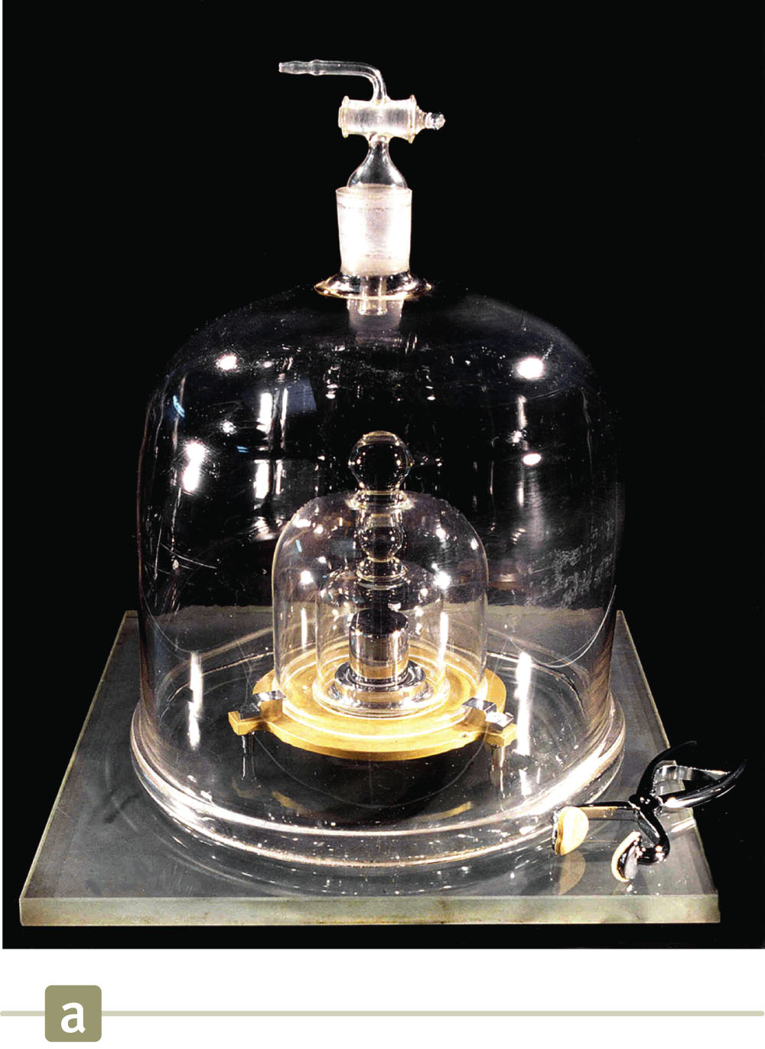
MASS
Units
  SI – kilogram, kg
Defined in terms of a kilogram, based on a specific (standard) cylinder kept at the International Bureau of Standards
Notes:
Thus, measurement consists of a “comparison” to a standard; the result is the magnitude (of a physical quantity); the magnitude must have a number and a unit. e.g. measurement of mass: 5 (meaningless); 5 kg (correct)

Slide 21
MASS, CONT’D
Measurement consists of a “comparison” to a standard; the result is the magnitude (of a physical quantity);
The magnitude must have a number and a unit.
e.g. measurement of mass: 5 (meaningless);
5 kg (correct)

Slide 22
TIME
Units
  seconds, s
Defined in terms of the oscillation of radiation from a cesium atom
Notes:
Draw a diagram

Slide 23
PREFIXES
Prefixes correspond to powers of 10.
Each prefix has a specific name.
Each prefix has a specific abbreviation.
The prefixes can be used with any basic units.
They are multipliers of the basic unit.
Examples:
  1 mm = 10⁻³ m
  1 mg = 10⁻³ g

Slide 24
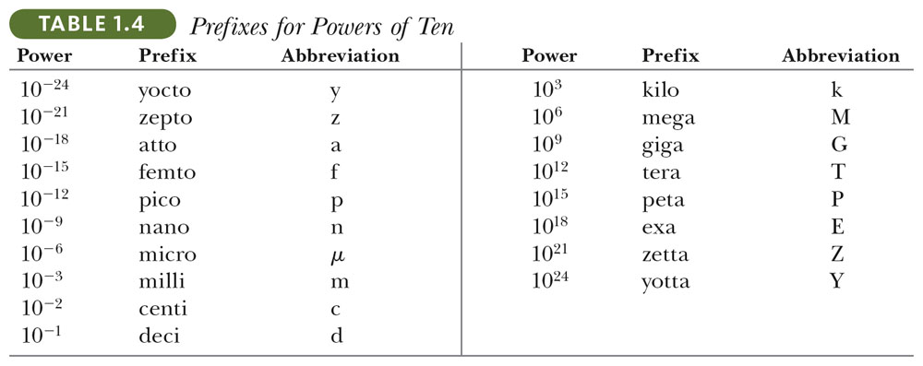
PREFIXES, CONT.
Notes:
Give examples on this

Slide 25
CONVERSION OF UNITS
When units are not consistent, you may need to convert to appropriate ones.
Units can be treated like algebraic quantities that can cancel each other out.
When quantities are added, subtracted, multiplied or divided in an algebraic equation, the unit can be treated like any other quantity

Slide 26
CONVERSION OF UNITS, EXAMPLE
The length(L) of a rectangle is 50 cm and width (W) is 150 cm. Determine its area, A=L x B
in:
(i) cm²
(ii) m²
Notes:
{i} 7500 (ii) 0.075

Slide 27
CONVERSIONS, CONT.
Suppose A=150 cm, B=1m, what is C & D?
C=A+B=150 +1=151? WRONG!!!
Here is the right approach: First convert A & B into the same units, e.g. cm
Use the conversion factor: 100 cm=1 m
A=150 cm =1.5 m, B=1m=100 cm
Therefore,
C=150 cm +100 cm=250 cm (or C=2.5 m)
D=150 cm-100 cm=50 cm (or D=0.5m)
ALWAYS CHECK DIMENSIONS

Slide 28
DIMENSIONS OF PHYSICAL QUANTITIES
Dimension has a specific meaning in physics – it denotes the physical nature of a quantity.
Dimensions are often denoted with square brackets.
  Length [L]
  Mass [M]
  Time [T]
  Note: Subtracting/adding two physical quantities is only possible if the quantities have the same dimensions, expressed in the same units
  Note: “You cannot add apples to oranges”.

Slide 29
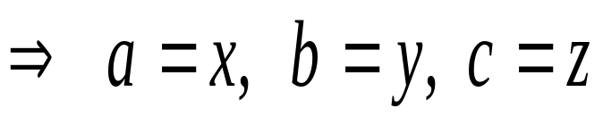
BASIS OF DIMENSIONAL ANALYSIS
[M]a [L]b [T]c = [M]x [L]y [T]z
Dimensional analysis is based on the following facts:
1. The Physical laws:
n₁a₁ = n₂a₂
2. Principle of Homogeneity:
Equations depicting physical situations must have the same dimensions throughout.
[M]ª [L]^{b} [T]^{c} = [M]^{x} [L]^{y} [T]^{z}

Slide 30
APPLICATIONS OF DIMENSIONAL ANALYSIS
Technique to check the correctness of an equation (or to assist in deriving an equation)
Dimensions (length, mass, time, combinations) can be treated as algebraic quantities. They obey simple algebra
  Add, subtract, multiply, divide
Both sides of equation must have the same dimensions.
Any relationship can be correct only if the dimensions on both sides of the equation are the same.
Limitation:
Dimensional analysis only gives units of numerical constants but not their values.

Slide 31
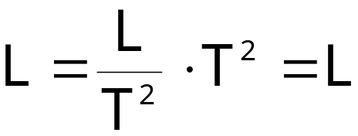
USING DIMENSIONAL ANALYSIS TO CHECK CORRECTNESS OF EQUATIONS
Given the equation: x = ½ at ²
[Note: a is acceleration and is measured in m/s², t in seconds(s)]
Check dimensions on each side:
The T²’s cancel, leaving L as the dimension of each side. Therefore,
  The equation is dimensionally correct.
  No dimensions for the constant, ½; neglect it.

Slide 32
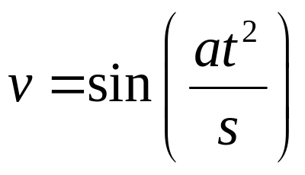
Check whether the following are dimensionally correct
Check whether the following are dimensionally correct
1. s = vt + at²;
2. s = vt² + 0.5at
3.

Slide 33


USE OF DIMENSIONAL ANALYSIS TO DETERMINE A POWER LAW
Determine powers in a proportionality
  Example: find the exponents in the expression
    You must have lengths on both sides since LHS has dimension of length.
    Acceleration has dimensions of L/T²
    Time has dimensions of T.
    Analysis gives

Slide 34
USING DIMENSIONAL ANALYSIS TO DETERMINE THE FORM OF EXPRESSIONS
Position (x) of a body under uniform acceleration is a function of time t and the acceleration (a).
Suppose we write this position as: x = ka^{m}t^{n,} where k is a dimensionless constant.
We can use dimensional analysis to find the values of m & n.
Final expression is: x = kat²
Note: Dimensional Analysis gives units of proportionality constants but provides no information about their numerical values

Slide 35
SCIENTIFIC NOTATION
Approximation based on a number of assumptions
  May need to modify assumptions if more precise results are needed
The order of magnitude is the power of 10 that applies.
Format: (number between 1 and 10) x 10^{exponent}
Very useful when handling very large or very small numbers

Slide 36
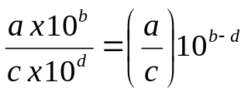
SCIENTIFIC NOTATION, EXAMPLES
Type 1:
100 = 1x10² = 10²
13 000 000 =1.3 x 10⁷
0.001=1 x 10⁻³
Type 2:
ax10^{b} x c x 10^{d} = ac x 10^{b+d}
1.2 x 10⁷ x 0.6 x 10⁻⁶ =(1.2 x 0.6) x 10⁷⁻⁶
= 0.72 x 10⁻¹
Type 3:
Note: 1 m = 10² cm ; 1 cm = 10⁻² m

Slide 37
SIGNIFICANT FIGURES
Many numbers are the result of measurements
A reliably known digit (other than a zero used to locate a decimal point) is called a significant figure
Examples:
  2.50 has 3 significant figures
2.504 has 4 significant figures
0.001201 has 4 significant figures
In a measurement, the significant figures include the first estimated digit.

Slide 38
SIGNIFICANT FIGURES, MORE DETAILS
0.0075 m has 2 significant figures
  The leading zeros are placeholders only.
  Write the value in scientific notation to show more clearly:
  7.5 x 10⁻³ m for 2 significant figures
10.0 m has 3 significant figures
  The decimal point gives information about the reliability of the measurement.
1500 m is ambiguous
  Use 1.5 x 10³ m for 2 significant figures
  Use 1.50 x 10³ m for 3 significant figures
  Use 1.500 x 10³ m for 4 significant figures

Slide 39
OPERATIONS WITH SIGNIFICANT FIGURES – ADDITION OR SUBTRACTION
The result of the addition or subtraction of two numbers has no significant numbers beyond the least decimal place where both of the original numbers had significant figures

Slide 40
SIGNIFICANT FIGURES, EXAMPLES
Be careful when using calculators, don’t use a digit off the calculator if it’s not significant
Example 1: 1.251 + 0.0721
Calculator gives 1.3231. However, the sum should have only 3 significant figures beyond the decimal point as 1.251 has 3 significant figures beyond the decimal point. Therefore, the answer should be 1.323
Notes:
Give examples on the rules

Slide 41
EXAMPLES
Example 1: 135 cm + 3.25 cm = ? cm
Example 2: 25.57 m x 2.45 m = ? m²
  Ans: 138cm . The 135 cm limits your answer to the units decimal value.
  Ans: 62.6 m². The 2.45 m limits your result to 3 significant figures.
Notes:
Ans: 138cm . The 135 cm limits your answer to the units decimal value.
Ans: 62.6 m². The 2.45 m limits your result to 3 significant figures.

Slide 42
OPERATIONS WITH SIGNIFICANT FIGURES – MULTIPLYING OR DIVIDING
When multiplying or dividing several quantities, the number of significant figures in the final answer is the same as the number of significant figures in the quantity having the smallest number of significant figures.
Example: 25.57 m x 2.45 m = 62.6 m²
  The 2.45 m limits your result to 3 significant figures.

Slide 43
OPERATIONS WITH SIGNIFICANT FIGURES – SUMMARY
The rule for addition and subtraction are different than the rule for multiplication and division.
For adding and subtracting, the number of decimal places is the important consideration.
For multiplying and dividing, the number of significant figures is the important consideration.

